Slide 1




Web
&
Internet
Class V
lab 11

Slide 2


Web Browser
A web browser is a type of software that allows you to find and view websites on the Internet

Slide 3

Address Bar
Each website has a unique address, called a URL . In browsers address bar you have to put the URL and hit to visit that website

Slide 4
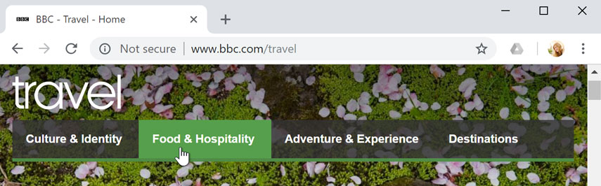
Links
Links are used to navigate the Web. When you click a link, it will usually take you to a different web page

Slide 5
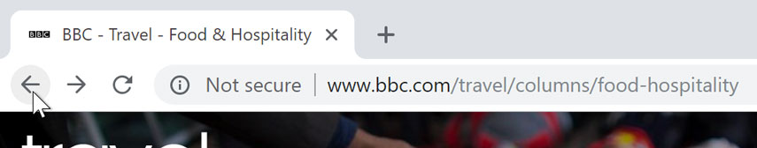
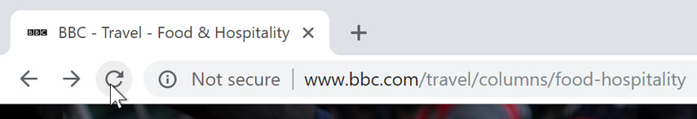
Navigation buttons
Navigation button alllows you to naviagte to forward, backward or reload current page

Slide 6
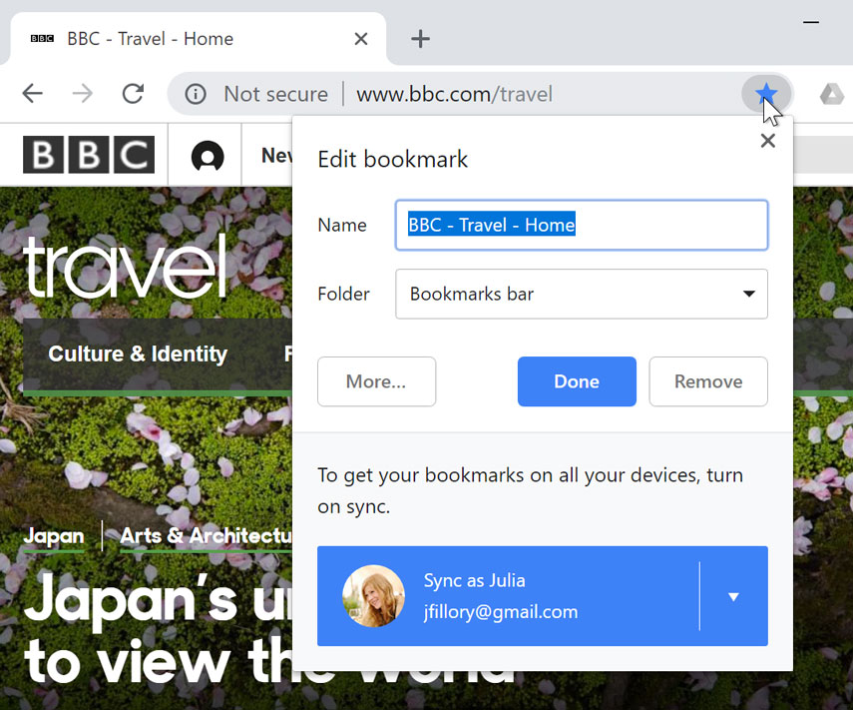
Bookmark
If you find a website you want to view later you just need to bookmark it

Slide 7


